Slide 1
Single-variate Linear Regression without Bias Term -for Several Samples-
Deep-Learning Seminar ch.6

Slide 2
contents
Computational Efficiency and Mini-batch
1
Theory
2
Vectorization
3
Backpropagation with NumPy
4
Implementation
5
Batch, Stochastic, Mini-batch Gradient Descent Methods - Theory
6
Batch, Stochastic, Mini-batch Gradient Descent Methods - Implementation
7
Batch, Stochastic, Mini-batch Gradient Descent - Comparison for Various Batch Sizes
8

Slide 3
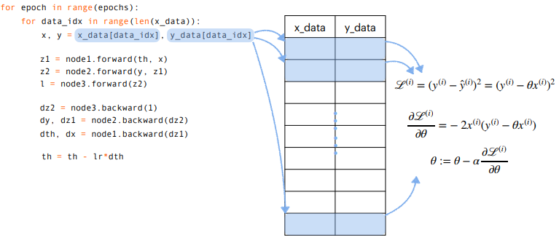
Computational Efficiency and Mini-batch
3

Slide 4
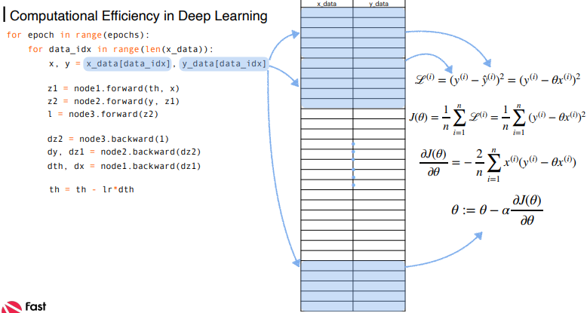
Computational Efficiency and Mini-batch
3

Slide 5
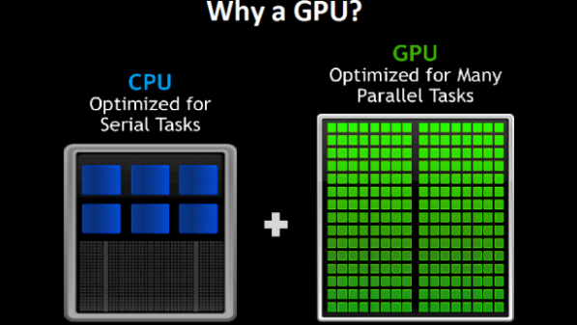
Computational Efficiency and Mini-batch
3

Slide 6
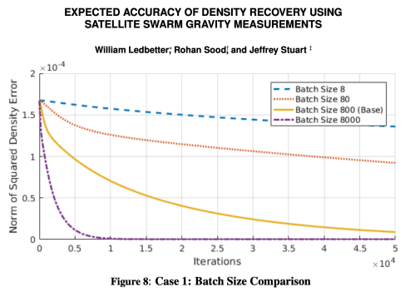
Computational Efficiency and Mini-batch
3

Slide 7
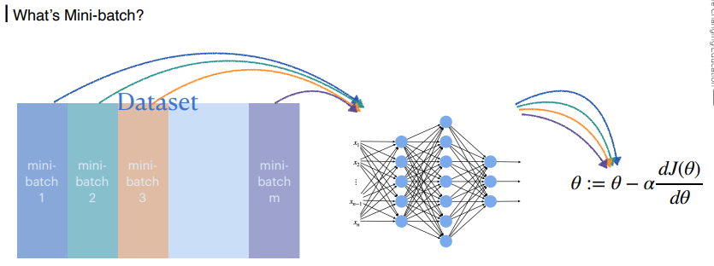
Computational Efficiency and Mini-batch
3

Slide 8
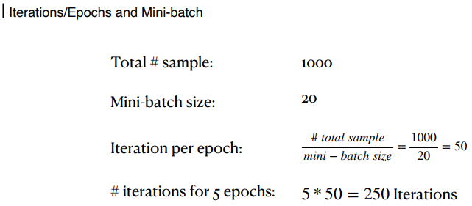
Computational Efficiency and Mini-batch
3

Slide 9
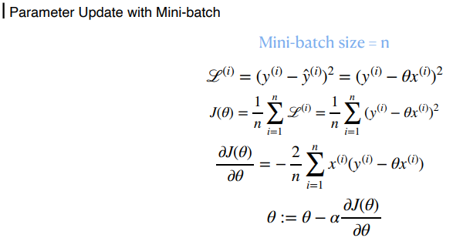
Computational Efficiency and Mini-batch
3

Slide 10
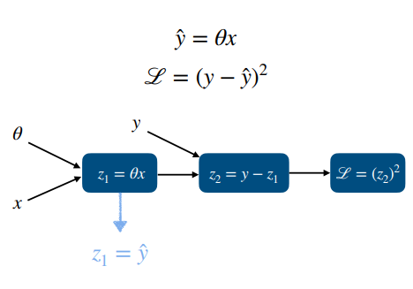
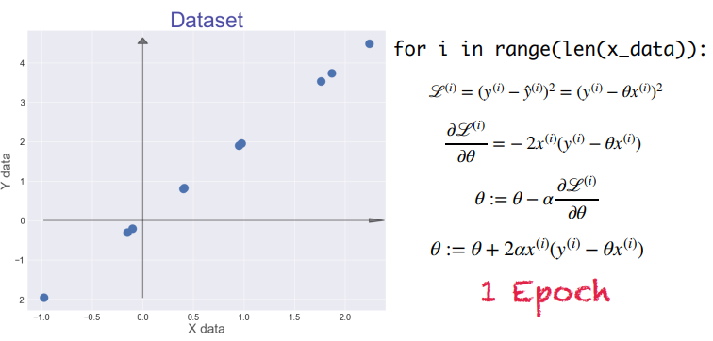
Theory
3

Slide 11
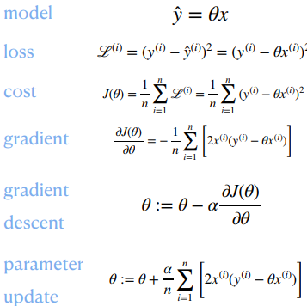
Theory
3

Slide 12
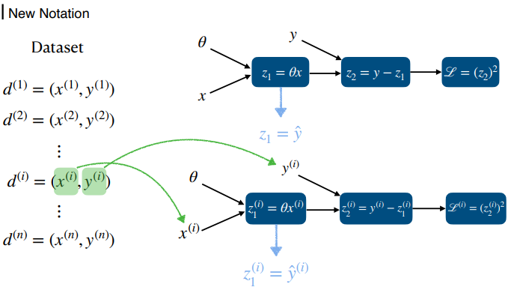
Theory
3

Slide 13
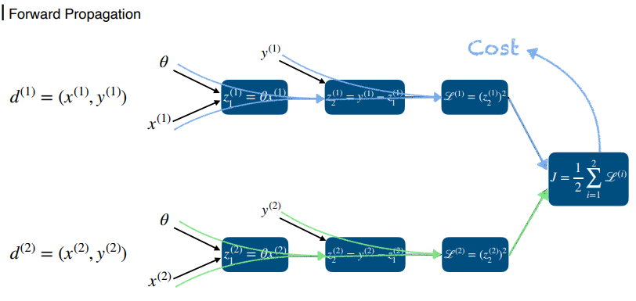
Theory
3

Slide 14
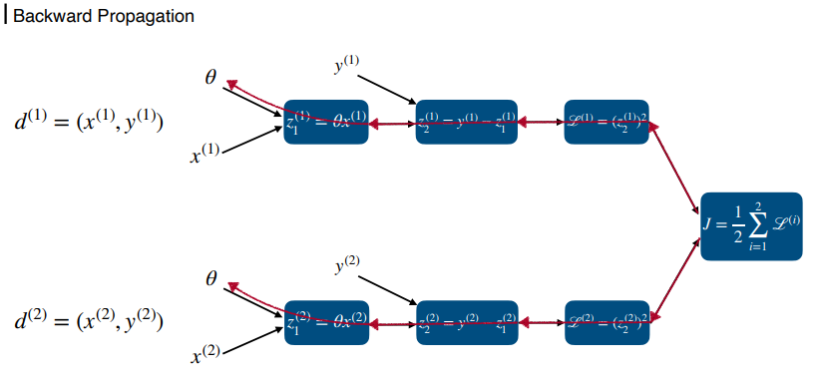
Theory
3

Slide 15
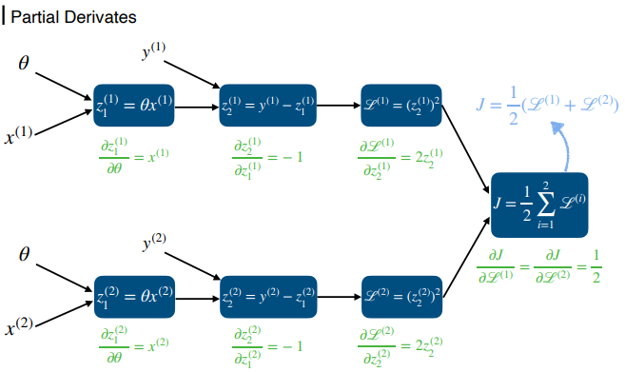
Theory
3

Slide 16
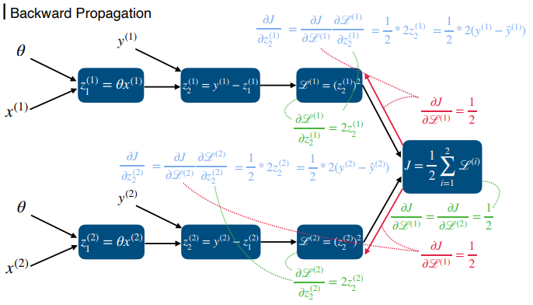
Theory
3

Slide 17
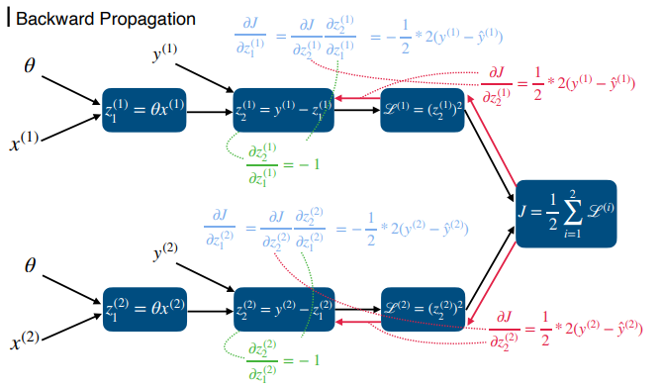
Theory
3

Slide 18
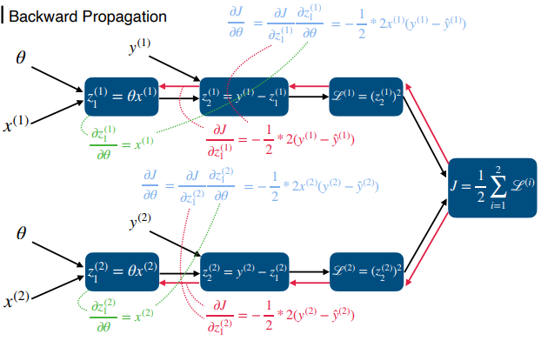
Theory
3

Slide 19
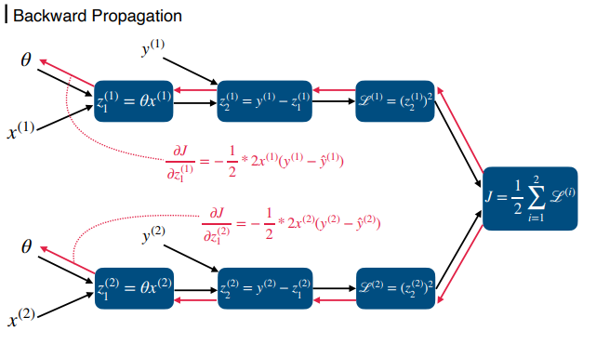
Theory
3

Slide 20
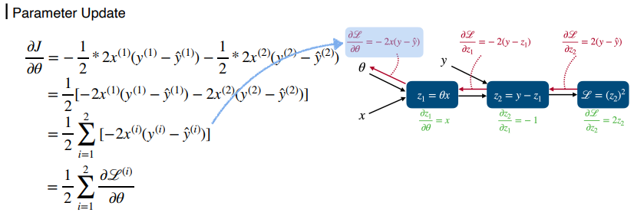
Theory
3

Slide 21
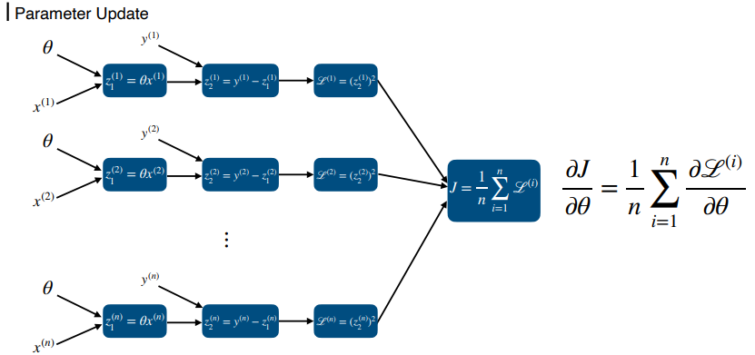
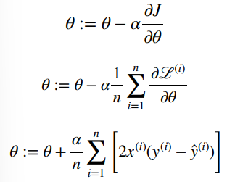
Theory
3

Slide 22
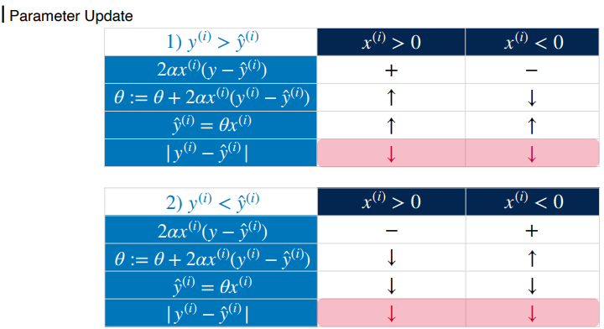
Theory
3

Slide 23
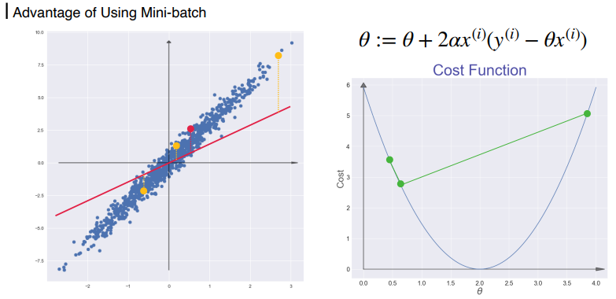
Theory
3

Slide 24
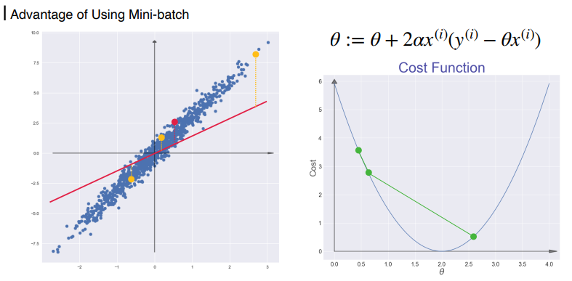
Theory
3

Slide 25
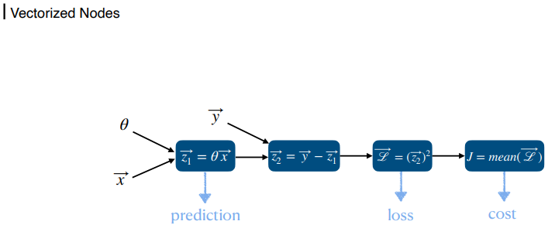
Vectorization
3

Slide 26
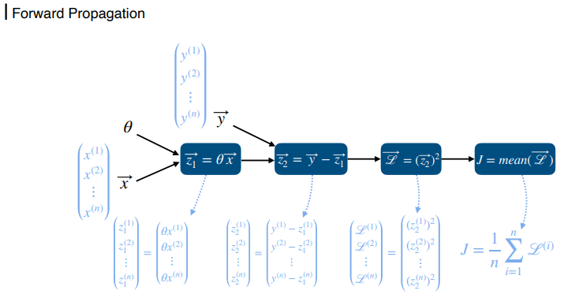
Vectorization
3

Slide 27
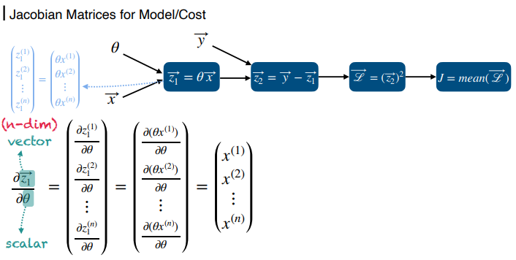
Vectorization
3

Slide 28
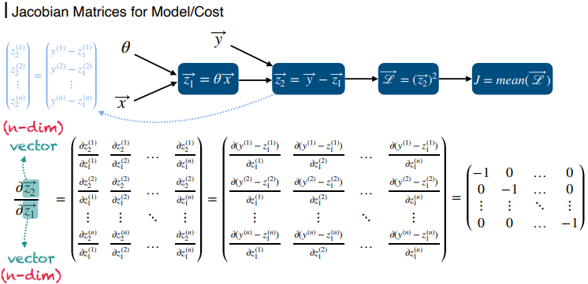
Vectorization
3

Slide 29
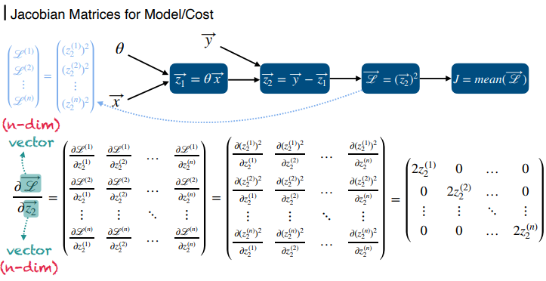
Vectorization
3

Slide 30
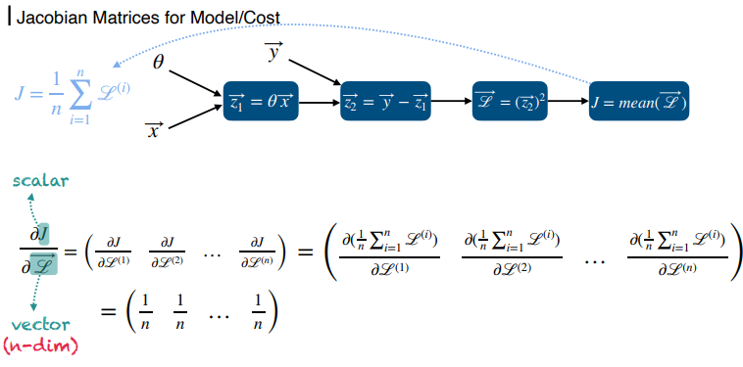
Vectorization
3

Slide 31
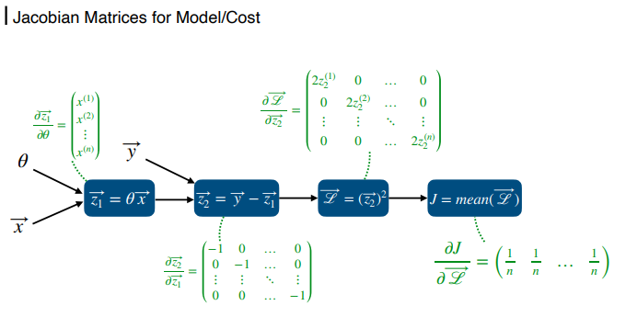
Vectorization
3

Slide 32
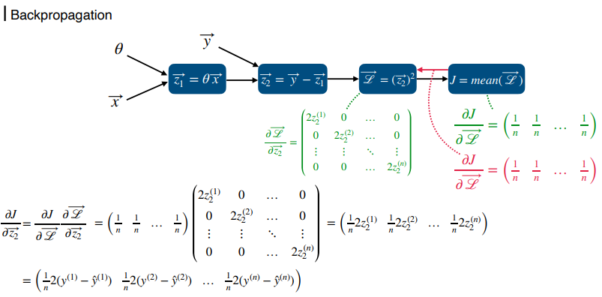
Vectorization
3

Slide 33
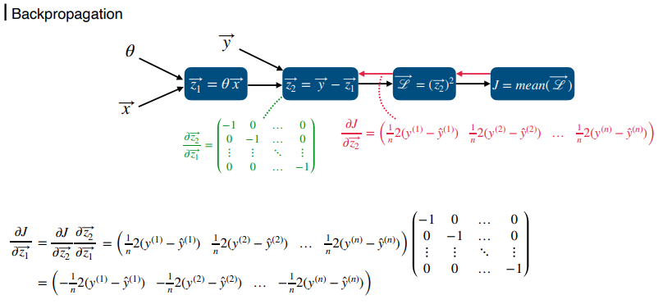
Vectorization
3

Slide 34
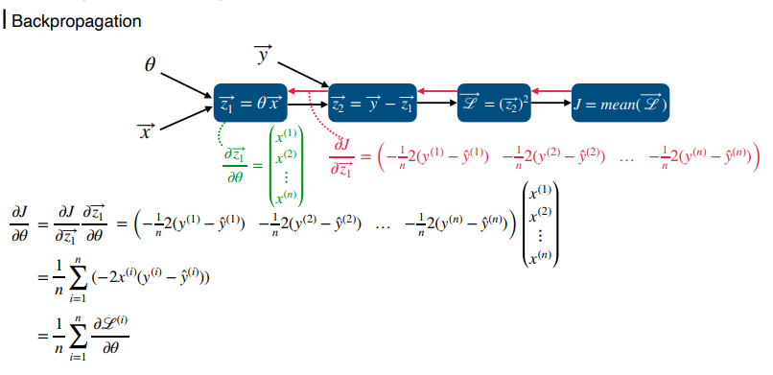
Vectorization
3

Slide 35
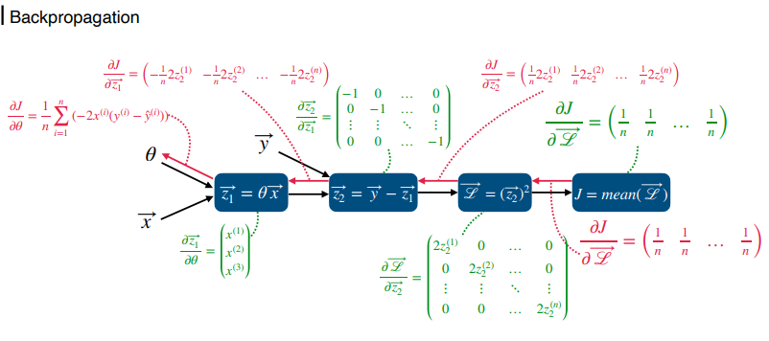
Vectorization
3

Slide 36
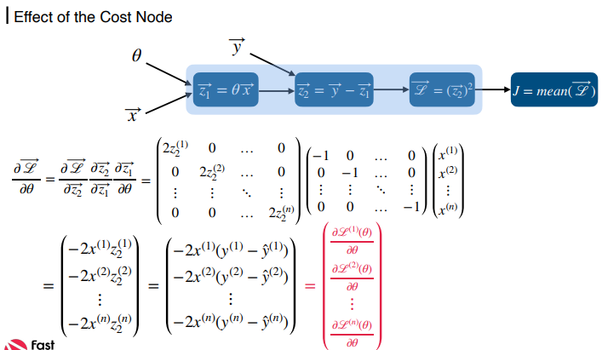
Vectorization
3

Slide 37
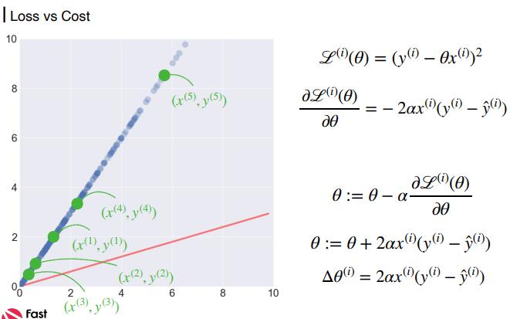
Vectorization
3

Slide 38
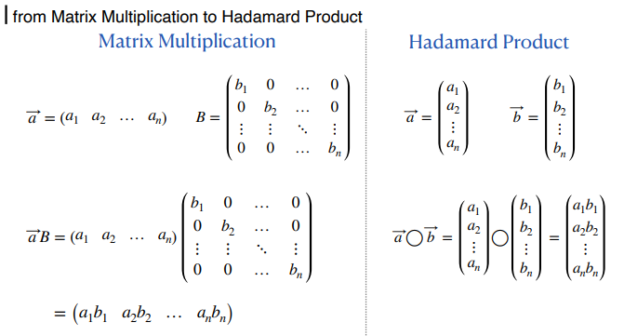
Backpropagation with NumPy
3

Slide 39
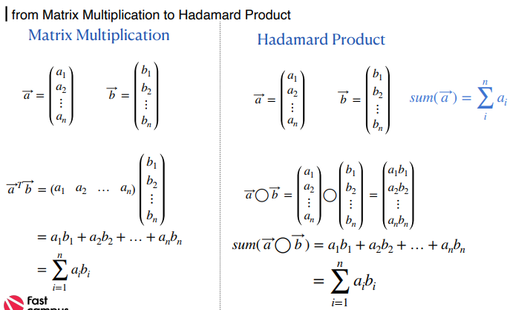
Backpropagation with NumPy
3

Slide 40
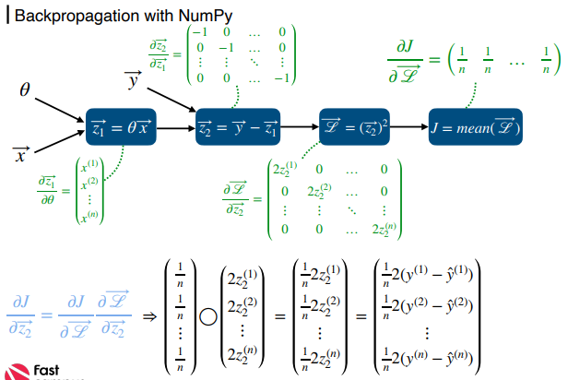
Backpropagation with NumPy
3

Slide 41
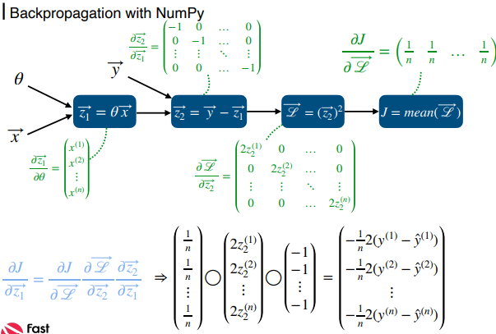
Backpropagation with NumPy
3

Slide 42
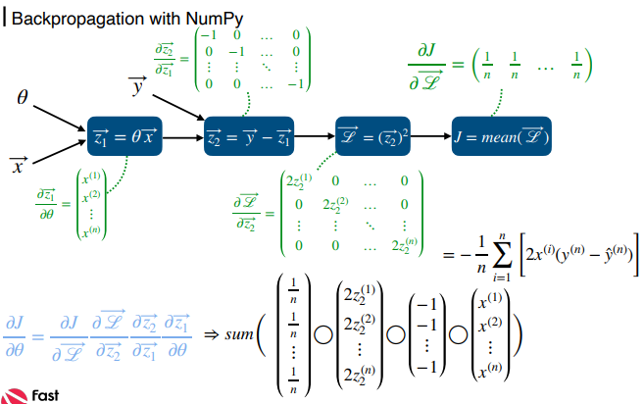
Backpropagation with NumPy
3

Slide 43
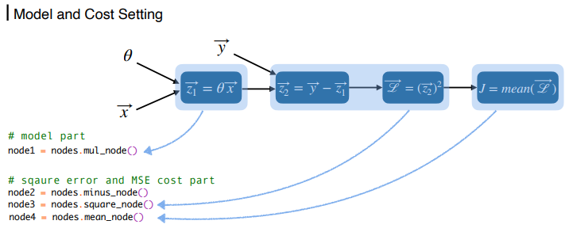
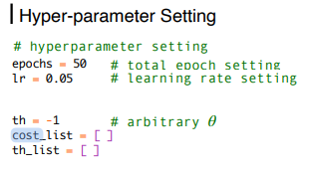
Implementation
3

Slide 44
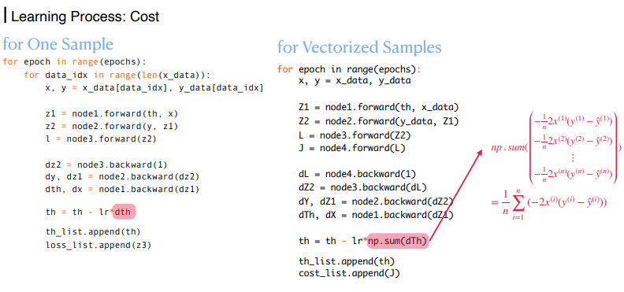
Implementation
3

Slide 45
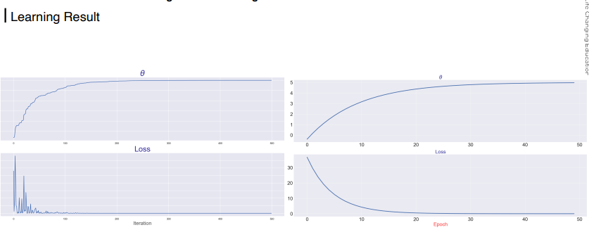
Implementation
3

Slide 46
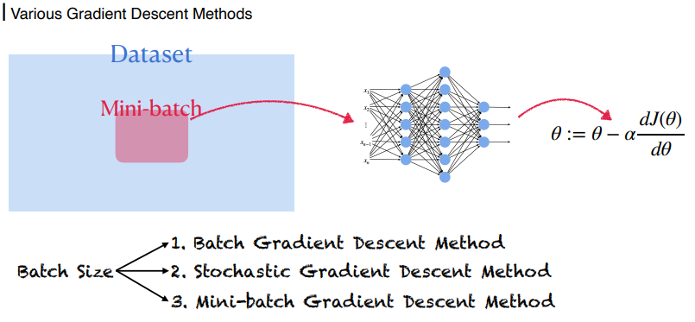
Batch, Stochastic, Mini-batch Gradient Descent Methods - Theory
3

Slide 47
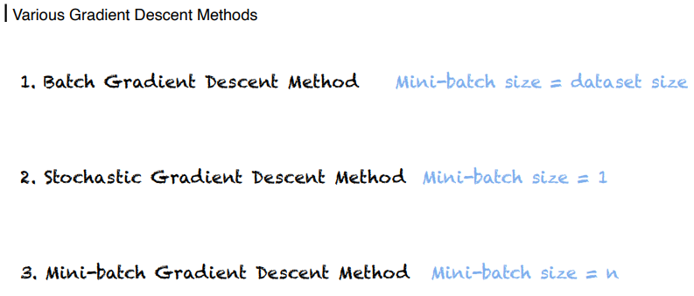
Batch, Stochastic, Mini-batch Gradient Descent Methods - Theory
3

Slide 48
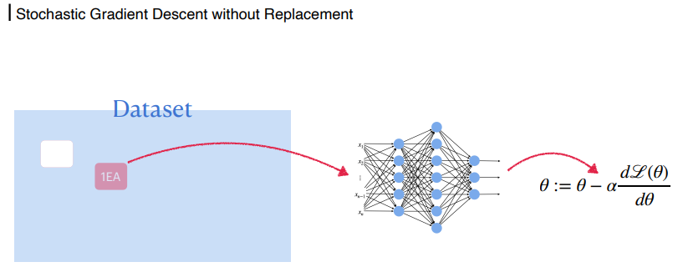
Batch, Stochastic, Mini-batch Gradient Descent Methods - Theory
3

Slide 49
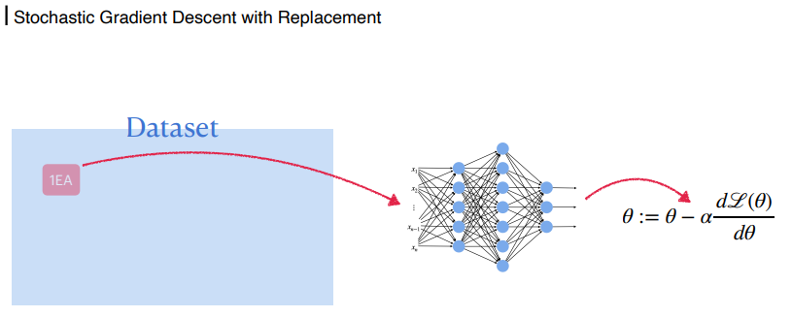
Batch, Stochastic, Mini-batch Gradient Descent Methods - Theory
3

Slide 50

Batch, Stochastic, Mini-batch Gradient Descent Methods - Theory
3

Slide 51

Batch, Stochastic, Mini-batch Gradient Descent Methods - Theory
3

Slide 52

Batch, Stochastic, Mini-batch Gradient Descent Methods - Theory
3

Slide 53

Batch, Stochastic, Mini-batch Gradient Descent Methods - Theory
3

Slide 54


Batch, Stochastic, Mini-batch Gradient Descent Methods - Implementation
3

Slide 55

Batch, Stochastic, Mini-batch Gradient Descent Methods - Implementation
3

Slide 56


Batch, Stochastic, Mini-batch Gradient Descent Methods - Implementation
3

Slide 57

Batch, Stochastic, Mini-batch Gradient Descent - Comparison for Various Batch Sizes
3

Slide 58

Batch, Stochastic, Mini-batch Gradient Descent - Comparison for Various Batch Sizes
3

Slide 59

Batch, Stochastic, Mini-batch Gradient Descent - Comparison for Various Batch Sizes
3

Slide 60

Batch, Stochastic, Mini-batch Gradient Descent - Comparison for Various Batch Sizes
3

Slide 61

Batch, Stochastic, Mini-batch Gradient Descent - Comparison for Various Batch Sizes
3

Slide 62
감사합니다.

